Slide 1



Lecture 21 Device Tree, Ubuntu and Linux Basics
How to Turn on Four LEDs?
Device Tree Introduction
Device Tree Usage (https://elinux.org/Device_Tree_Usage#Sample_Machine)
Zybo Device Tree (https://github.com/DigilentInc/Linux-Digilent-Dev)
Device Tree and Device Driver
Oracle Virtual Box and Ubuntu Installation
Unix Operating System: Kernel and Shell
Linux File System
Linux Shell Command Line Interface
Terminal
Basic Shell Commands

Slide 2
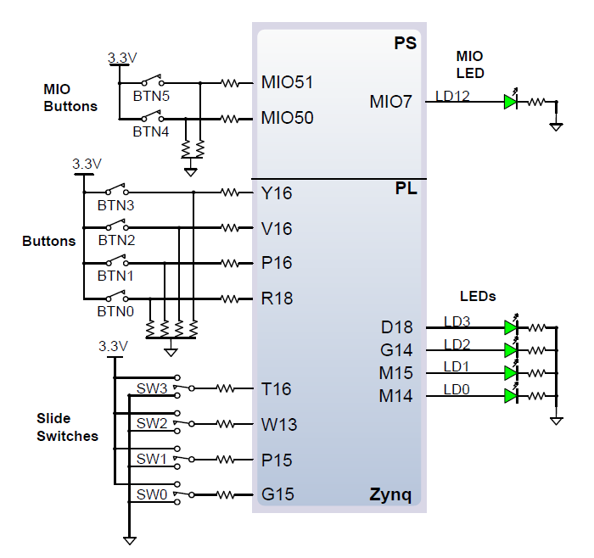
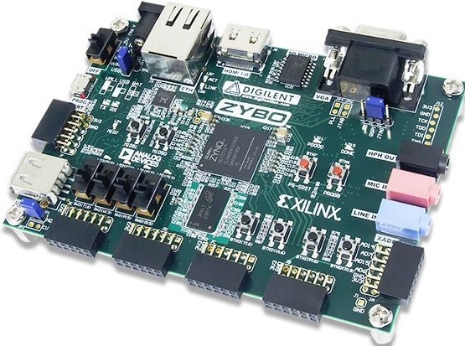
How to Turn on and off four LEDs?

Slide 3
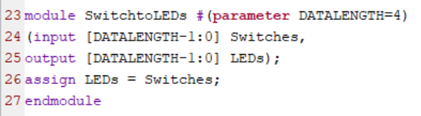
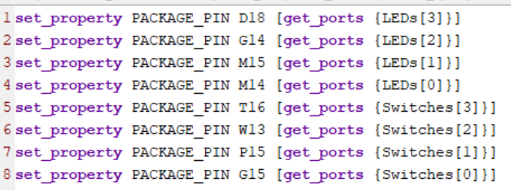
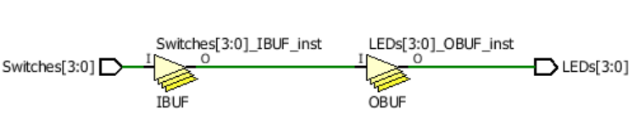
How to Turn on four LEDs: Hardware pin connection
A hardware approach: LEDs = Switches;

Slide 4
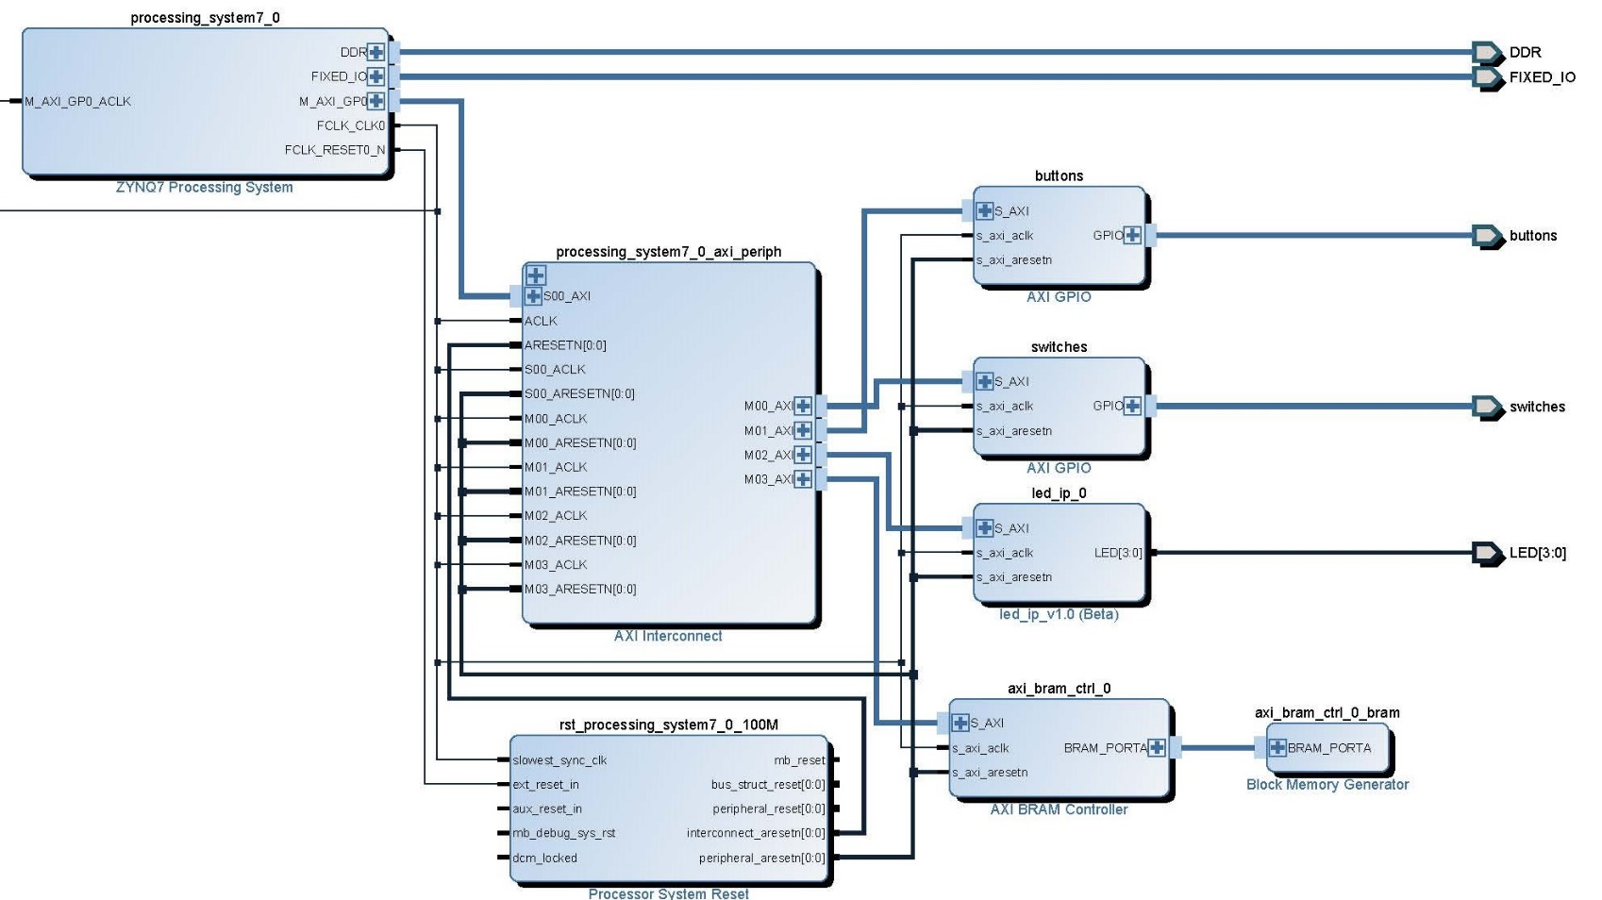
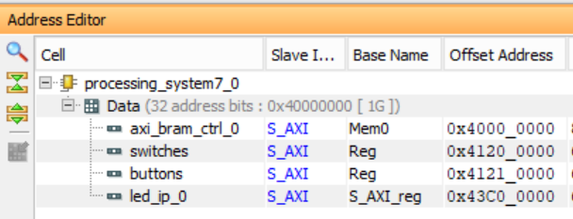
How to Turn on four LEDs: LED IP address at 0x43C00000

Slide 5
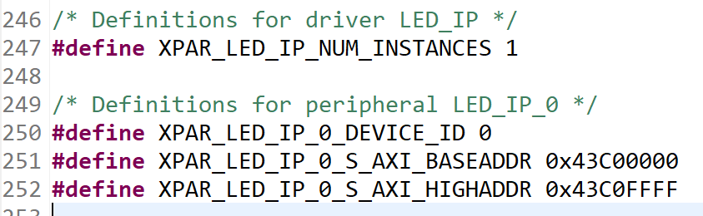
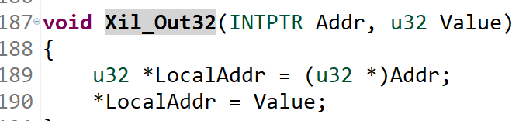
How to Turn on four LEDs: Write to LED IP address
Write to Address 0x43C00000 from xparameters.h
Simple Level 1 software driver is called, which uses Level 0 driver

Slide 6
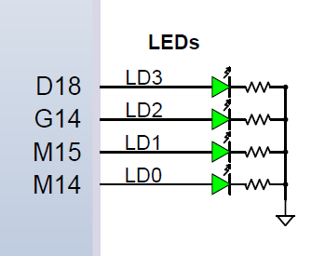
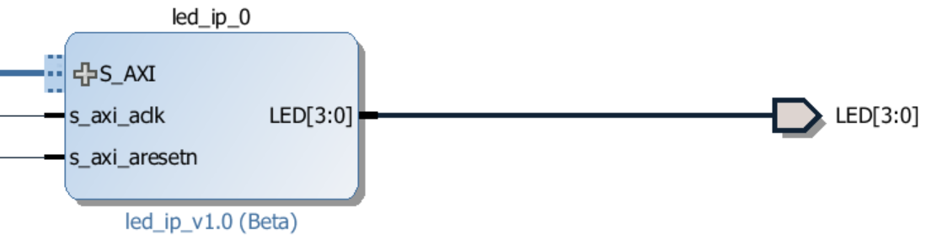
How to Turn on four LEDs: Write to a file in Linux
fp = fopen("/proc/led_ip", "w");
fputs("0x0F\n", fp);
fclose(fp);
led_ip file
/* Define Driver Name */
#define DRIVER_NAME "led_ip"
….
static const struct of_device_id myled_of_match[] = {
{.compatible = "JianjianSong, led_ip_0"},
{},
};
Device tree
*Name, ID
*base address
led_ip {
compatible = "JIanjianSong, led_ip_0";
reg = <0x43C3000 0x10000>;
}
Device driver

Slide 7
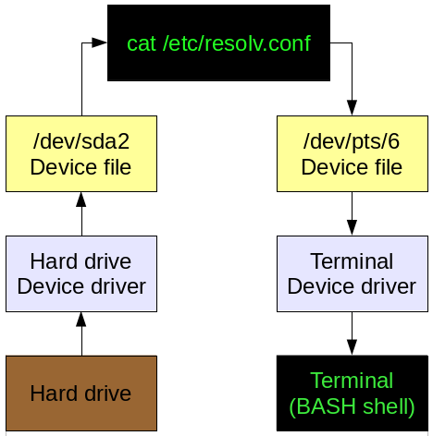
Every Device is a File
Everything on a Linux computer is accessible as a file in the file system space.
Command cat reads file /etc/resolv.conf and displays text on the file on a terminal
cat sends request to File /dev/sda2 to ask for the file
File /etc/resolv.conf is on hard drive and is sent by Hard Drive Device Driver to device file /dev/sda2
cat reads /dev/sda2 and sends data to file /dev/pts/6
Terminal Device Driver gets data from /dev/pts/6 and sends data to Terminal
Managing devices in Linux
https://opensource.com/article/16/11/managing-devices-linux

Slide 8
Pros and Cons on How to Turn on four LEDs
Hardware
Access point is direct pin connection
Easy to implement but hard to change pin numbers
Bare Metal Application
Access point is a direct address
Pin assignment can be changed as long as the address is the same
OS Support, i.e., Linux
Access point is a file pointer, any application can use this device
Device driver has the same device node name as that in the device tree
Device level change can be updated through device tree
Pin assignment can be done independent of the device driver
USB Example: each USB device has its own driver that needs to be installed and updated when the device is updated. The update is transparent to applications that use the USB device.

Slide 9
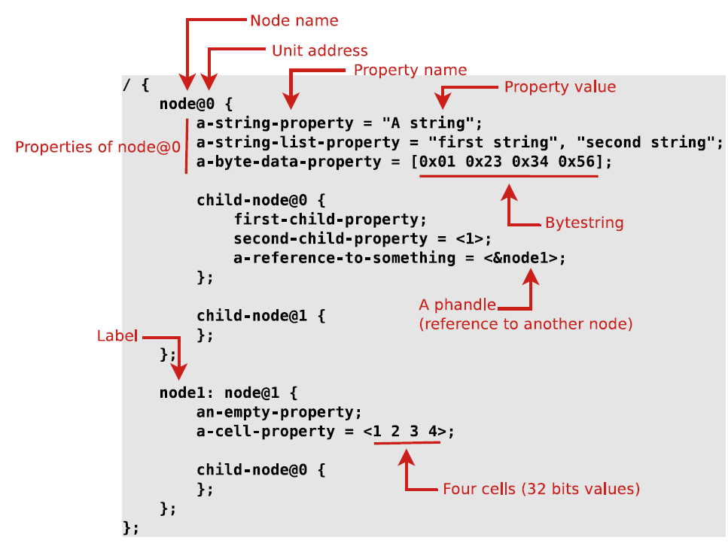
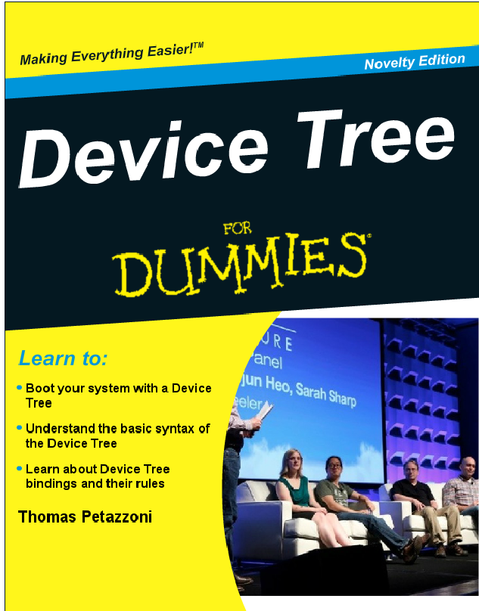
Device Tree
A device tree is a tree data structure with nodes that describe the physical devices in a system
Thomas Petazzoni
https://elinux.org/images/f/f9/Petazzoni-device-tree-dummies_0.pdf

Slide 10
A Tree Structure of Nodes and Properties
Nodes are groupings of properties and child nodes
A single root node: / { };
Children nodes: node1 { child_node1 { }; child_node2 { }; };
Properties are Key-Value Pairs
Text strings “my string”
Cells are 32 bit unsigned integers delimited by angle brackets: <0xdeadbeef 11 0xf00d>
Binary data with square brackets: [0x01 0x02 0x03 0x04]
mixed data, concatenate with a comma
“my string”, <0xdeadbeef>, [0x04], “your string”
Commas are also to create lists of strings: “red”, “blue”;
Compatible = “” uniquely specifies a node for an OS to identify the node

Slide 11
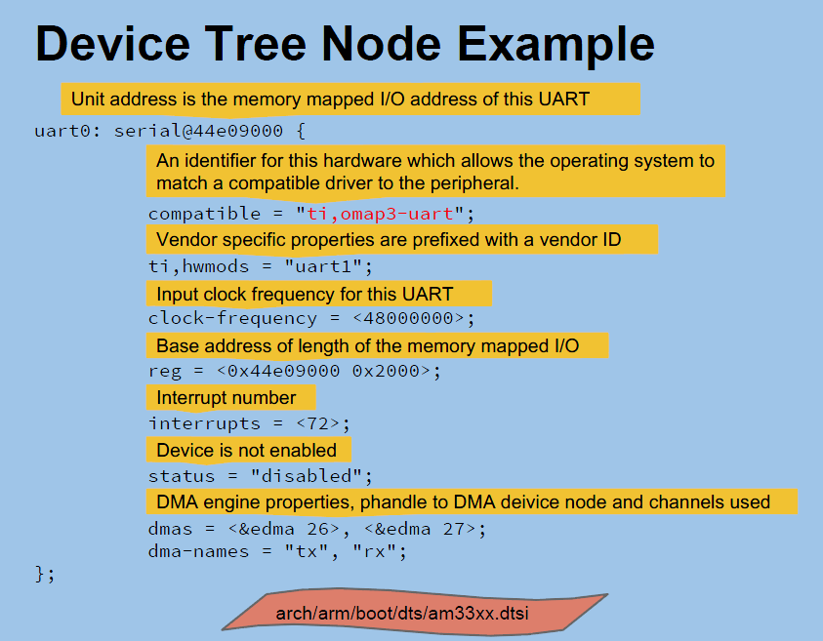
Matt Porter
Konsulko
mporter@konsulko.com

Slide 12
An Imaginary Sample Machine (http://elinux.org/Device_Tree_Usage#Sample_Machine.)
manufactured by "Acme“ (loosely based on ARM)
Named "Coyote's Revenge“ One 32bit ARM CPU
processor local bus attached to memory mapped serial port, spi bus controller, i2c controller, interrupt controller, and external bus bridge
256MB of SDRAM based at 0
2 Serial ports based at 0x101F1000 and 0x101F2000
GPIO controller based at 0x101F3000
SPI controller based at 0x10170000 with following devices
MMC slot with SS pin attached to GPIO #1
External bus bridge with following devices
SMC SMC91111 Ethernet device attached to external bus based at 0x10100000
i2c controller based at 0x10160000 with following devices
Maxim DS1338 real time clock. Responds to slave address 1101000 (0x58)
64MB of NOR flash based at 0x30000000

Slide 13
An Imaginary Sample Machine (http://elinux.org/Device_Tree_Usage#Sample_Machine.)
Initial structure – root node and device names
/ {
compatible = “acme,coyotes-revenge”;
};
Compatible contains <manufacturer>, <model>, used by Linux to decide how to run the machine
The OS could find the details of this machine if the details are kept
CPUs – a child node for each CPU. ARM Dual-core Cortex-A9
/ {
compatible = “acme,coyotes-revenge”;
cpus@0 {
compatible = “arm, cortex-a9”;
};
cpus@1 {
compatible = “arm, cortex-a9”;
};
};

Slide 14
An Imaginary Sample Machine (http://elinux.org/Device_Tree_Usage#Sample_Machine.)
Node Names - <name>[@<unit-address>]
Name can be up to 31 characters in length
Unit-address is included so that the node is identified by an address, base address of the device registers
Device nodes - every device is represented by a device tree node.
This tree is incomplete as information about connections between devices is missing.
/ { compatible = "acme,coyotes-revenge";
cpus { cpu@0 { compatible = "arm,cortex-a9"; };
cpu@1 { compatible = "arm,cortex-a9"; }; };
serial@101F0000 { compatible = "arm,pl011"; };
serial@101F2000 { compatible = "arm,pl011"; };
gpio@101F3000 { compatible = "arm,pl061"; };
interrupt-controller@10140000 { compatible = "arm,pl190"; };
spi@10115000 { compatible = "arm,pl022"; };
external-bus { ethernet@0,0 {
compatible = "smc,smc91c111"; };
i2c@1,0 { compatible = "acme,a1234-i2c-bus";
rtc@58 { compatible = "maxim,ds1338"; };
};
flash@2,0 { compatible = "samsung,k8f1315ebm", "cfi-flash"; };
};
};

Slide 15
An Imaginary Sample Machine (http://elinux.org/Device_Tree_Usage#Sample_Machine.)
Compatible is a list of strings: <manufacturer>, <model>
flash@2,0 { compatible = "samsung,k8f1315ebm", "cfi-flash"; };
Manufacturer = Samsung, k8f1315ebm
Model = cfi-flash
Addressing: each <address1 lengh1> is a tuple
reg: reg = <address1 length1 [address2 length2] [address3 length3] >
#address-cells: how many addresses are in a tuple
#size-cells: how many lengths are in a tuple
CPU addressing
One address in a tuple
No length (size) in a tuple
cpus {
#address-cells = <1>;
#size-cells = <0>;
cpu@0 {
compatible = "arm,cortex-a9";
reg = <0>;
};
cpu@1 {
compatible = "arm,cortex-a9";
reg = <1>;
};
};
@0 is the base address of cpu0

Slide 16
An Imaginary Sample Machine (http://elinux.org/Device_Tree_Usage#Sample_Machine.)
Memory Mapped Device – base address and number of registers
One address in a tuple
One length in a tuple
/ {
#address-cells = <1>; //one address
#size-cells = <1>; ... //one length or size
serial@101f0000 {
compatible = "arm,pl011";
reg = <0x101f0000 0x1000 >;
};
gpio@101f3000 {
compatible = "arm,pl061";
reg = <0x101f3000 0x1000
0x101f4000 0x0010>;
};
};
@101f000 is base address of serial
Base Address
size

Slide 17
An Imaginary Sample Machine (http://elinux.org/Device_Tree_Usage#Sample_Machine.)
Non Memory Mapped Device, device@1,0
i2c device has #address cell=1 and #size cells=0, i.e., i2c@1,0
It is not mapped into memory space
It register has three fields: chip select number, offset address, length
i2c@1,0 {
compatible = "acme,a1234-i2c-bus";
#address-cells = <2>; //one address
#size-cells = <1>; //no size data
reg = <1 0 0x1000>;
//real time clock value is accessible at address 58
rtc@58 {
compatible = "maxim,ds1338";
reg = <58>;
};
};

Slide 18
An Imaginary Sample Machine (http://elinux.org/Device_Tree_Usage#Sample_Machine.)
Interrupts – page 7
Interrupt controller is defined as intc: interrupt_controller@10100000
Interrupt controller is a parent node at root level that takes care of all interrupts
Each interrupt has a vector number and triggering event: edge, level, high state, low state, etc.
/ {
compatible = "acme,coyotes-revenge";
#address_cellts = <1>;
#size_cells = <1>;
//interrupt controller parent node
interrupt-parent = <&intc>;
intc: interrept-controller@10140000 {
compatible = “arm, p1190”;
reg = <0x10140000 0x1000>;
interrupt-controller;
#interrupt-cells = <2>;
};
serial@101f0000 {
compatible = “arm, p1011”;
reg = <0x101f0000 0x1000;
interrupts = <1 0>;
};
gpio@101f3000 {
compatible = “arm, p1061”;
reg = <0x101f3000 0x1000 0x101f4000 0x0010>;
interrupts = <3 0>;
};
};

Slide 19
An Imaginary Sample Machine (http://elinux.org/Device_Tree_Usage#Sample_Machine.)
Aliases – a short name for a device
Chosen mode
serves as a place for passing data between firmware and the OS, like boot arguments.
aliases {
ethernet0 = &eth0;
serial0 = &serial0;
};
chosen {
bootargs = "root=/dev/nfs rw nfsroot=192.168.1.1 console=ttyS0,115200";
};

Slide 20
zynq-zybo.dts: CPUs, UART1, Generic Interrupt Controller (GIC)
/dts-v1/;
/ {
#address-cells = <1>;
#size-cells = <1>;
compatible = "xlnx,zynq-7000";
model = "Xilinx Zynq";
aliases {
ethernet0 = &ps7_ethernet_0;
serial0 = &ps7_uart_1;
spi0 = &ps7_qspi_0;
} ;
chosen {
bootargs = "console=ttyPS0,115200 root=/dev/ram rw earlyprintk";
linux,stdout-path = "/amba@0/serial@e0001000";
} ;
cpus {
#address-cells = <1>;
#size-cells = <0>;
ps7_cortexa9_0: cpu@0 {
bus-handle = <&ps7_axi_interconnect_0>;
clock-latency = <1000>;
clocks = <&clkc 3>;
compatible = "arm,cortex-a9";
device_type = "cpu";
interrupt-handle = <&ps7_scugic_0>;
operating-points = <666667 1000000 333334 1000000 222223 1000000>;
reg = <0x0>;
} ;
Source:
https://github.com/DigilentInc/Linux-Digilent-Dev.

Slide 21
ps7_cortexa9_1: cpu@1 {
bus-handle = <&ps7_axi_interconnect_0>;
clocks = <&clkc 3>;
compatible = "arm,cortex-a9";
device_type = "cpu";
interrupt-handle = <&ps7_scugic_0>;
reg = <0x1>;
} ;
} ;
pmu {
compatible = "arm,cortex-a9-pmu";
interrupt-parent = <&ps7_scugic_0>;
interrupts = <0 5 4>, <0 6 4>;
reg = <0xf8891000 0x1000>, <0xf8893000 0x1000>;
reg-names = "cpu0", "cpu1";
} ;
ps7_ddr_0: memory@0 {
device_type = "memory";
reg = <0x0 0x20000000>;
} ;
ps7_uart_1: serial@e0001000 {
clock-names = "uart_clk", "pclk";
clocks = <&clkc 24>, <&clkc 41>;
compatible = "xlnx,xuartps", "cdns,uart-r1p8";
current-speed = <115200>;
device_type = "serial";
interrupt-parent = <&ps7_scugic_0>;
interrupts = <0 50 4>;
port-number = <0>;
reg = <0xe0001000 0x1000>;
xlnx,has-modem = <0x0>;
} ;
ps7_scugic_0: ps7-scugic@f8f01000 {
#address-cells = <2>;
#interrupt-cells = <3>;
#size-cells = <1>;
compatible = "arm,cortex-a9-gic", "arm,gic";
interrupt-controller ;
num_cpus = <2>;
num_interrupts = <96>;
reg = <0xf8f01000 0x1000>, <0xf8f00100 0x100>;
} ;

Slide 22
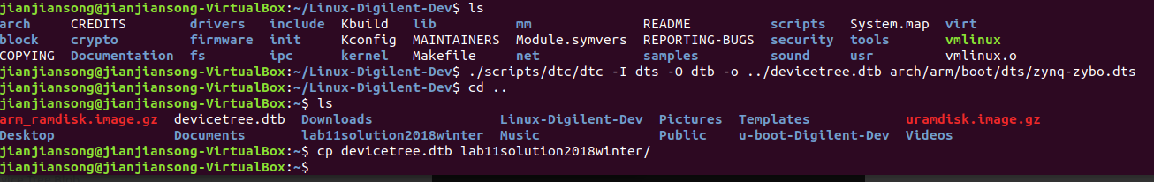
Compile the DTB File under Linux
A device tree blob (DTB file) is needed to boot Linux
Get the Linux kernel source code from Digilent Git repository: https://github.com/DigilentInc/Linux-Digilent-Dev.
Default configuration for Zybo is located at arch/arm/configs/xylinx_zynq_defconfig.
There is a zynq-zybo.dts in \u-boot-digilent-master\arch\arm\dts from u-boot-digilent-master.zip
Device tree compiler dtc can be called to make a DTB file from DTS file
./scripts/dtc/dtc –I dts –O dtb –o ../devicetree.dtb arch/arm/boot/dts/zynq-zybo.dts

Slide 23
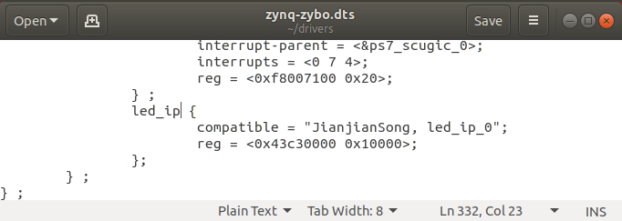
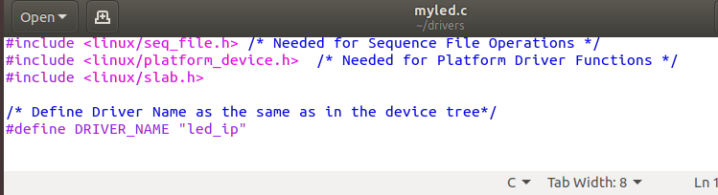
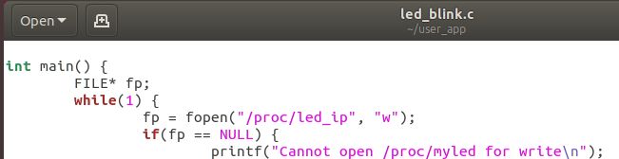
LED IP Device Node Name Is Unique and Consistent: led_ip
The base address of LED IP device led_ip_0 is 0x43C30000
This is the address of the LED device is transferred to the device tree file: zynq-zybo.dts
The LED IP device node name is led_ip
Device driver must refer to the node name led_ip to access the device tree
File open and close statement must also refer to process /proc/led_ip

Slide 24
Device Node Name: led_ip in zynq-zybo.dts
} ;
ps7_xadc: ps7-xadc@f8007100 {
clocks = <&clkc 12>;
compatible = "xlnx,zynq-xadc-1.00.a";
interrupt-parent = <&ps7_scugic_0>;
interrupts = <0 7 4>;
reg = <0xf8007100 0x20>;
} ;
led_ip {
compatible = "JianjianSong, led_ip_0";
reg = <0x43C3000 0x10000>;
};
led_ip

Slide 25
Device Driver Name: led_ip in Device Driver Code myled.c
#include <linux/kernel.h>
#include <linux/module.h>
#include <asm/uaccess.h> /* Needed for copy_from_user */
#include <asm/io.h> /* Needed for IO Read/Write Functions */
#include <linux/proc_fs.h> /* Needed for Proc File System Functions */
#include <linux/seq_file.h> /* Needed for Sequence File Operations */
#include <linux/platform_device.h> /* Needed for Platform Driver Functions */
/* Define Driver Name */
#define DRIVER_NAME "led_ip"
unsigned long *base_addr; /* Virtual Base Address */
struct resource *res; /* Device Resource Structure */
unsigned long remap_size; /* Device Memory Size */
led_ip
/* device match table to match with device node in device tree */
static const struct of_device_id myled_of_match[] = {
{.compatible = "JianjianSong, led_ip_0"},
{},
};

Slide 26
Application code: fopen() and fclose() in led_blink.c
#include <stdio.h>
#include <stdlib.h>
#include <unistd.h>
int main()
{
FILE* fp;
while(1) {
fp = fopen("/proc/led_ip", "w");
if(fp == NULL) {
printf("Cannot open /proc/myled for write\n"); return -1; }
fputs("0x0F\n", fp);
fclose(fp);
sleep(1);
fp = fopen("/proc/led_ip", "w");
if(fp == NULL) {
printf("Cannot open /proc/myled for write\n"); return -1; }
fputs("0x00\n", fp);
fclose(fp);
sleep(1);
} return 0; }
/proc/led_ip

Slide 27
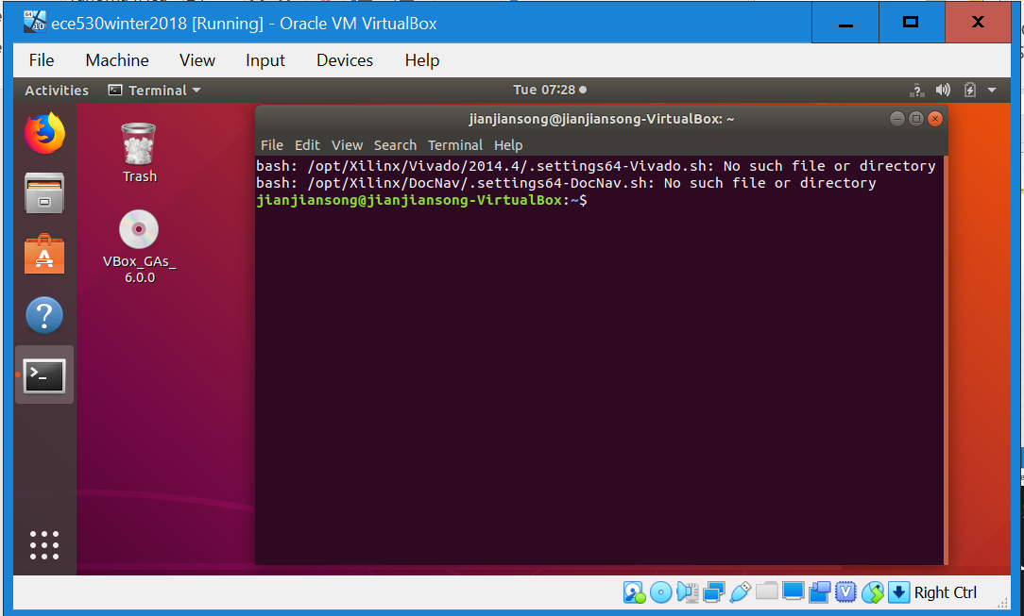
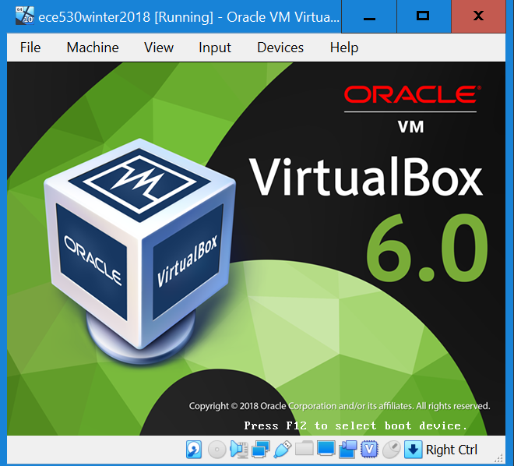
Oracle Virtual Box and Ubuntu Linux
VirtualBox is a x86 and AMD64/Intel64 virtualization product and it supports creation and management of guest virtual machines.
Ubuntu is a free and open-source Linux based on Debian.
Notes:
CMSC 121 Introduction to UNIX
Much of the material in these slides was taken from
Dan Hood’s CMSC 121 Lecture Notes.

Slide 28

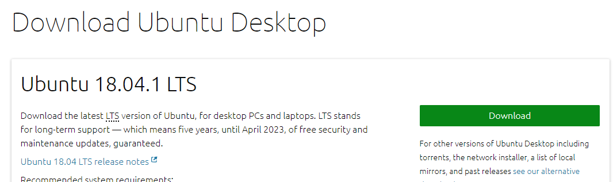
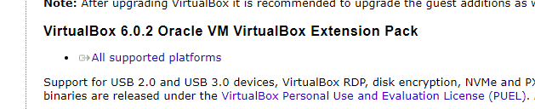
VirtualBox and Ubuntu Download and Installation
VirtualBox at https://www.virtualbox.org/.
Ubuntu is a free and open-source Linux based on Debian.
ubuntu-16.04-desktop-amd64.iso (1.45 GB)
VM VirtualBox Extension Pack: (Oracle_VM_VirtualBox_Extension_Pack-6.0.2.)
Notes:
CMSC 121 Introduction to UNIX
Much of the material in these slides was taken from
Dan Hood’s CMSC 121 Lecture Notes.

Slide 29
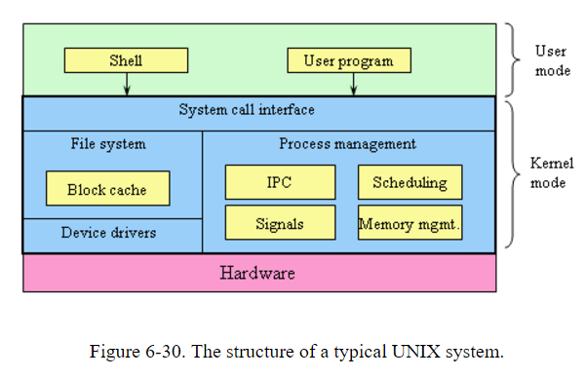
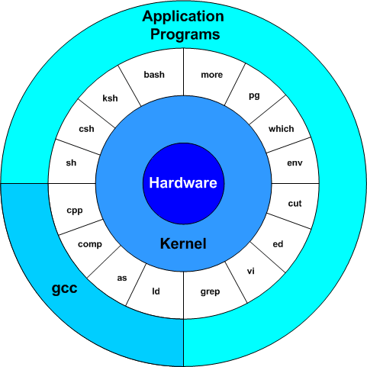
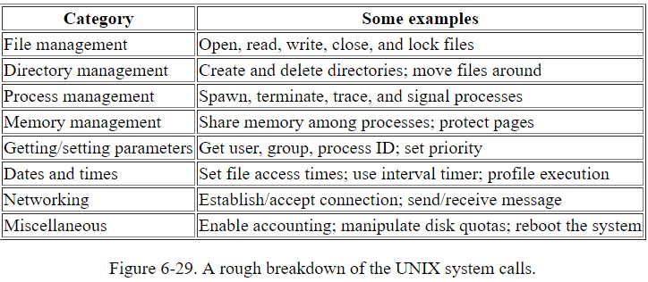
Unix Operating System: Kernel and Shell
Kernel – device drivers, file system, process management (Inter-process communication, interrupts, scheduling), memory management
Shells – user interface programs, command line interfaces (terminals)
X Windows and GUI are in user mode outside he kernel
http://www.johnloomis.org/ece314/notes/OperatingSystems/UNIX.html
Notes:
CMSC 121 Introduction to UNIX
Much of the material in these slides was taken from
Dan Hood’s CMSC 121 Lecture Notes.

Slide 30
Unix Functionally Organized at Three Levels
- Surrounding the kernel and acting as a user interface to the Unix operating system
- Command language interpreter
- Interprets the command users enter
- Selects and runs the command or program
- Provides the results to the screen or file as
directed by the command
C shell, Bourne shell, Korn shell
offering additional functionality to the operating system
Tools and applications
shell
The main part of operating system, and responsible for controlling system resources.
Loaded into memory when the system boots
Process control and scheduling
Memory management
Device I/O
System error handling
User programs requesting services from the kernel through system calls
Hardware devices getting kernel response through interrupts
kernel
kernel

Slide 31
Linux File System
Linux has an hierarchical, unified file system
Supports 256-character filenames.
All command line entries are case sensitive.
Use the slash(/) rather than the backslash(\) you have been using in DOS.
Ordinary files
text files
data files
command text files
executable files
directories
links
rather than having multiple copies of a file, Linux uses linking to one file to save disk space.
special device files

Slide 32
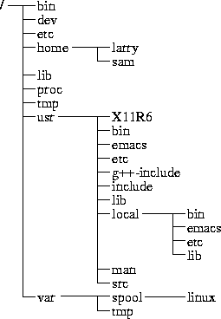
File Directory Tree
/- Root – the top of directory tree (cd / to change to root)
/bin – essential user binaries (executable programs)
/dev – device files for physical or pseudo devices
/home – a user’s home directory (cd ~ to get to home directory)
/lib – essential shared libraries
/mnt – temporary mount points to mount file systems
/opt – optional software packages
/proc – kernel & process files
/root – home directory for root user
/etc – system configuration files
Command pwd shows current directory

Slide 33
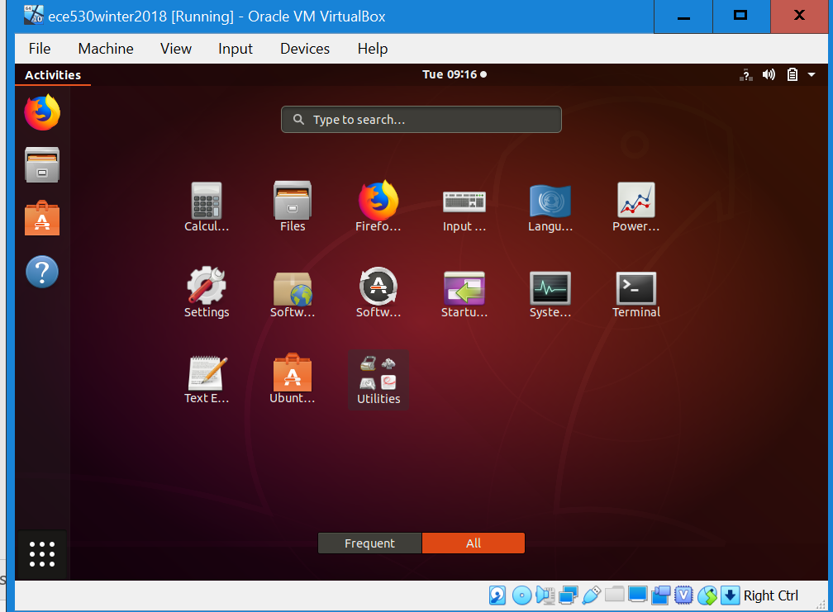
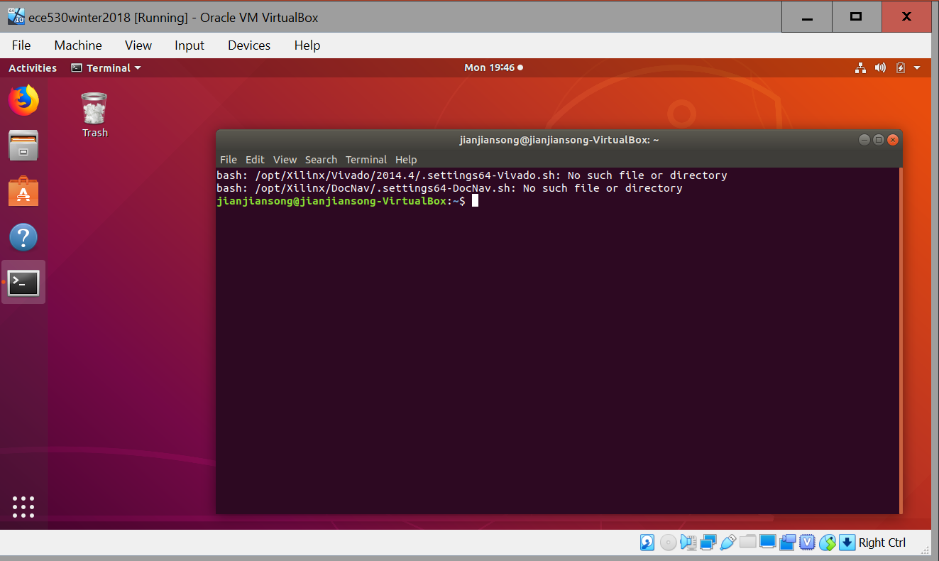
Ubuntu Windows and Terminals under Oracle VirtualBox
Ctrl+Alt+t to start a terminal
You can also click on the bottom left corner to show applications. Click on terminal icon to start it.
When typing a file or directory name, type first few letters and hit Tab to complete the name

Slide 34
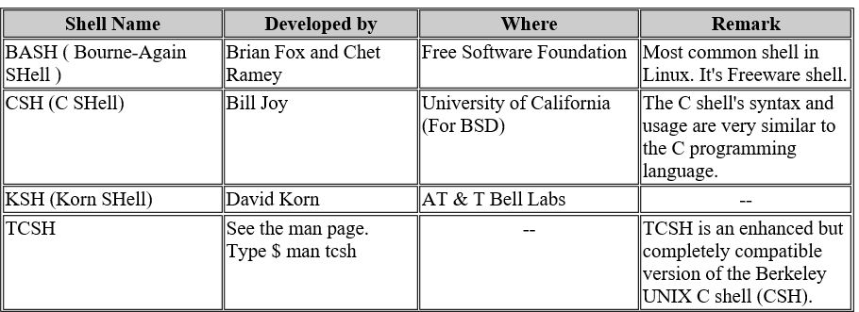
Linux Shell is a User Program
Shell is a user program or it's environment provided for user interaction.
Shell is an command language interpreter that executes commands read from the standard input device (keyboard) or from a file.
Shell is not part of system kernel, but uses the system kernel to execute programs, create files etc.
To find all available shells in your system type following command: $ cat /etc/shells
Each shell does the same job, but each understand a different command syntax and provides different built-in functions

Slide 35
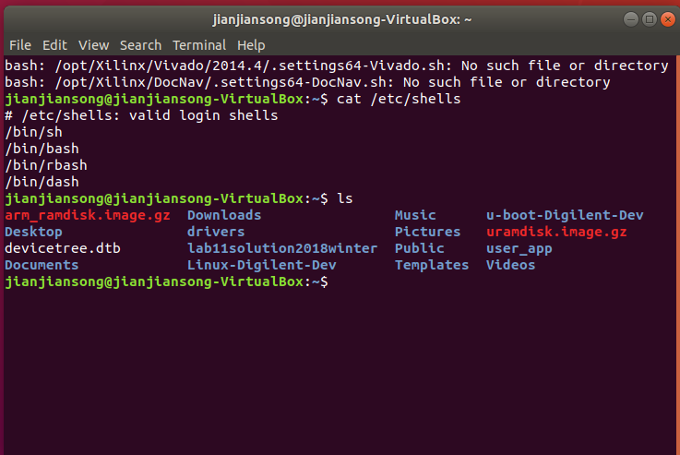
A Command Line Interface Terminal
A terminal is a wrapper program that runs a shell
A terminal is what a user sees
Available shells: cat /etc/shells

Slide 36
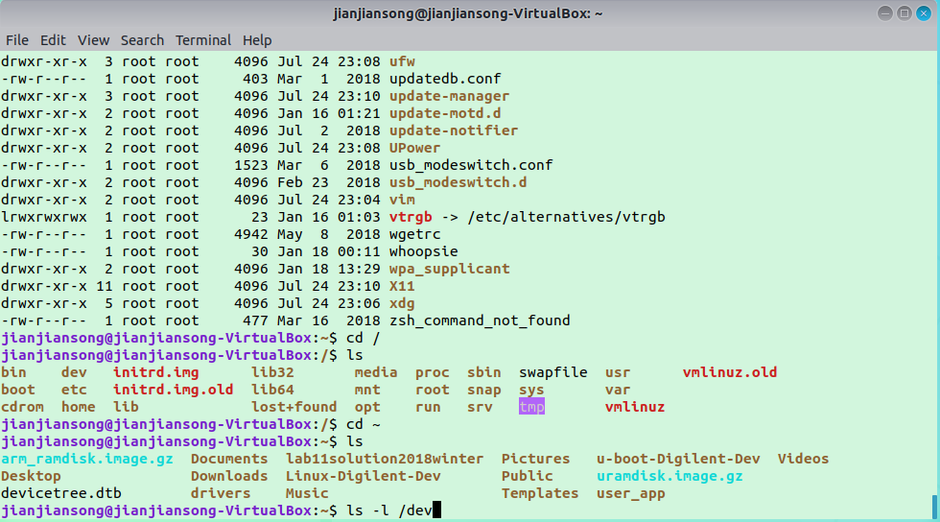
Ubuntu Linux Command Line Terminal
Terminal command: command name options arguments
ls –l /dev
Connecting commands with pipes (|) – output of a command to be input of another command
ls –l /dev | grep dvd
PgUp ↑and PgDn ↓ to recall commands

Slide 37
Linux Shell Terminal Commands (tab to complete file/dir name)
sudo – prefix to elevated privileges to root level.
man COMMANDNAME to display manual or help page of a command.
ls to display files in this directory.
ls –a to list hidden files.
ls –l to display details of files.
ls /proc to display all processes
ls /dev to display all devices
cd directory name to go to a directory.
cd ~ to go to home directory.
cd / to go to root directory.
mkdir name and rmdir name to create or remove a directory.
rm FILENAME to remove a file or directory.
rm –fr to remove forcibly and recursively a directory and all files in its sub directory.

Slide 38
cp to copy a file.
cp file new_file to copy file to a copy called new_file.
mv to move a file from another directory or rename a file
chmod to change permissions of a file.
chmod –x file to make the file executable.
chmod 755 file to assign root permissions to the file.
insmod FILENAME [options] to insert a module into the Linux kernel.
mount to mount a file system
locate to find location of a file
df to find disk space usage
zip, unzip to compress a file into a zip archive or extract a zipped file
tar to work with tarball archive files such as .tar, .tar.gz, .tar.bz2, etc.
tar –xvf to untar a tar archive.
source FILENAME to read and execute commands from filename.
pwd to display current directory

Slide 39
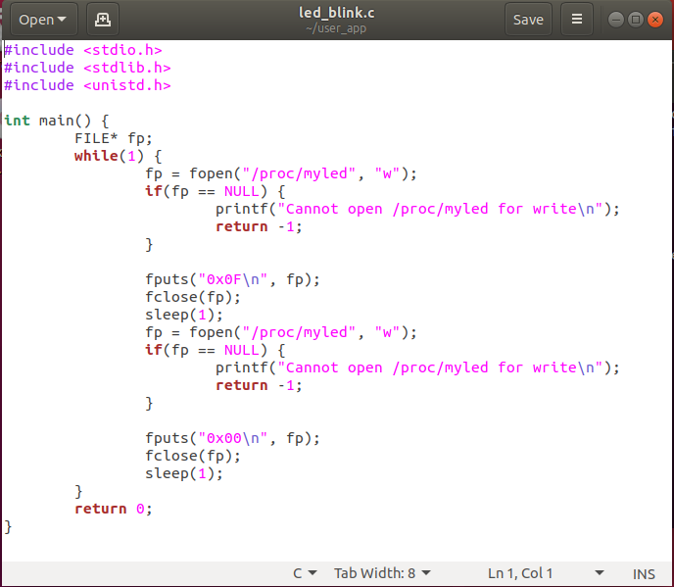

Text Editor gedit
gedit is the GNOME text editor.
GNOME (/(ɡ)noʊm/) is a free and open-source desktop environment for Unix-like^{[10]} operating systems.
Ctrl+S to save current document
Ctrl+W to close current document
Ctrl+Q to quit gedit
Ctrl+Z to undo last action
Ctrl+C to copy selected text
Ctrl+V to paste content of clipboard
Ctrl+A to select all text
Ctrl+D to delete current line
Ctrl+F to find a string
F1 to get user’s guide

